Slide 1
Introduction to Data Analytics
Class #3
Multidimensional Data
Dr. Sreeja S R
Assistant Professor
Indian Institute of Information Technology
IIIT Sri City

Slide 2
Quote of the day..

Slide 3
Today’s discussion…
Multidimensional Data Model
Data Cube
Data cube aggregation
Data cube segregation
Data representation

Slide 4
Questions from measurement scales
Your toothpaste brand: Colgate, Closeup, Himalaya, Dabur, etc..
North of Darjeeling, West Midnapore, Southern tip of Tamilnadu, etc..

Slide 5
Interval Scales
Discrete variable: Discrete variable is the quantitative data, but its values cannot be expressed or presented in the form of a decimal; for example, number of males, number of females, number of patients, and family size cannot expressed in decimal in meaningful way.
Continuous data: Data are measured in values and can be quantified and presented in decimals. Age, height, weight, body mass index, serum creatinine, heart rate, systolic blood pressure, and diastolic blood pressure are some examples.

Slide 6
Data STORAGE

Slide 7
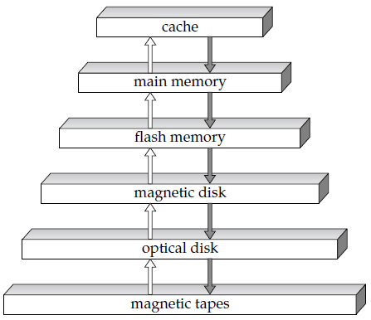
Storage device hierarchy

Slide 8
Data Cube
Multidimensional Data Modeling

Slide 9
Concept of data cube
A multidimensional data model views data in the form of a cube.
A data cube is characterized with two things
Dimension: the perspective or entities with respect to which an organization wants to keep record.
Fact: The actual values in the record
Example.
Rainfall data of Metrological Department
Time (Year, Season, Month, Week, Day, etc.)
Location (Country, Region, State, etc.)

Slide 10
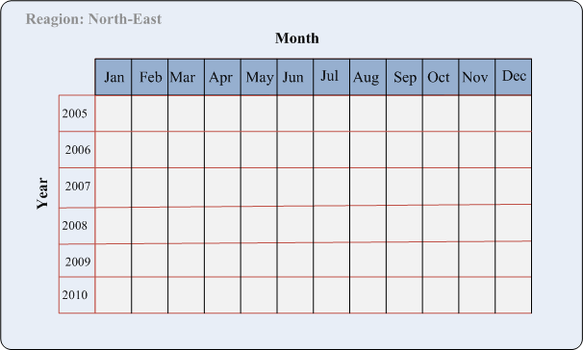
2-D view of rainfall data
In this 2-D representation, the rainfall for “North-East” region are shown with respect to different months for a period of years

Slide 11
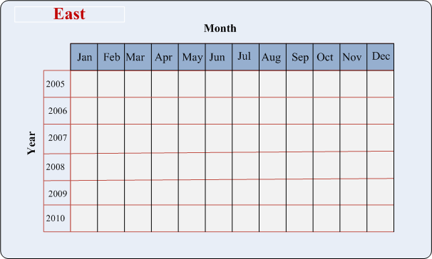

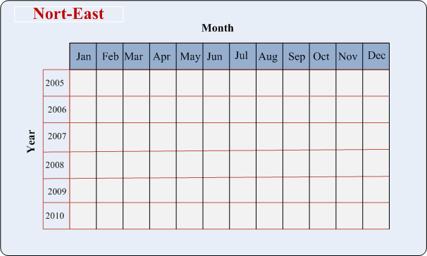
3-D view of rainfall data
Suppose, we want to represent data according to times (Year, Month) as well as regions of a country say East, West, North, North-East, etc.
A 2-D view of 3-D rainfall data

Slide 12
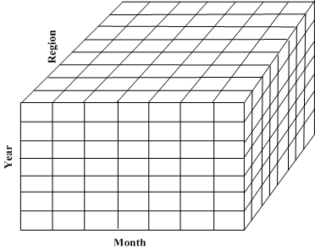
3-D view of rainfall data
Data cube: This enables us a 3-D view of the rainfall data

Slide 13
3-D view of rainfall data
India
China
Russia
Pakistan
Data cube: This enables us a 3-D view of the rainfall data for a continent say?

Slide 14
3-D view of rainfall data
What is the data cube representation of rainfall data of the entire world?

Slide 15
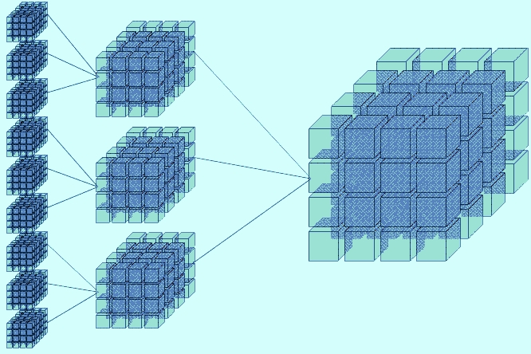
Data cube aggregation
ROLL UP
DRILL DOWN

Slide 16
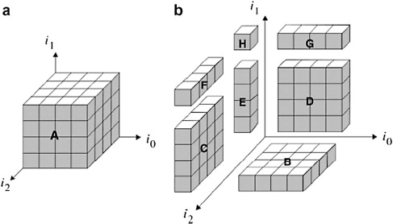
Data cube segregation
BASE CUBOID
SLICE

Slide 17

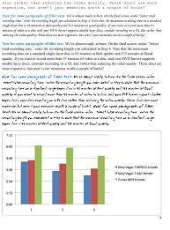
Data representation
How a document (e.g., text) can be represented?

Slide 18

Data representation
How an image can be represented?

Slide 19

Data representation
How a video can be represented?

Slide 20

Data representation
How the streaming data from an artificial earth satellite can be represented?

Slide 21
Reference
The detail material related to this lecture can be found in
Data Mining: Concepts and Techniques (3rd Edn.) by Jiawei Han, Michelline Kamber and Jian Pei, Morgan Kaufmann (2014).

Slide 22
Any question?

Slide 23
Questions of the day…
Give the concept of data cube to represent hyper-dimensional data? Also, explain with suitable diagrams the following.
Roll up
Drill down
Slice
Using the concept of data cube, how YouTube can archive videos of all type?

